Slide 1

Social Media Analytics (Group E)
By: Sawaira Niaz

Slide 2
Introduction
📌 Dataset Overview
Source: Kaggle – Social Media Engagement Dataset
Size: 9,000 records, 9+ columns
Platforms Covered: Instagram, Facebook, TikTok, LinkedIn, Twitter
Key Metrics:
Follower Count, Posts Per Week, Engagement Rate
Ad Spend (USD), Conversion Rate, Campaign Reach
📌 Objectives of the Analysis
Identify top-performing social media platforms based on engagement.
Evaluate Return on Investment (ROI) for ad spending.
Understand how post frequency impacts follower growth.
Determine cost efficiency of conversions across platforms.

Slide 3
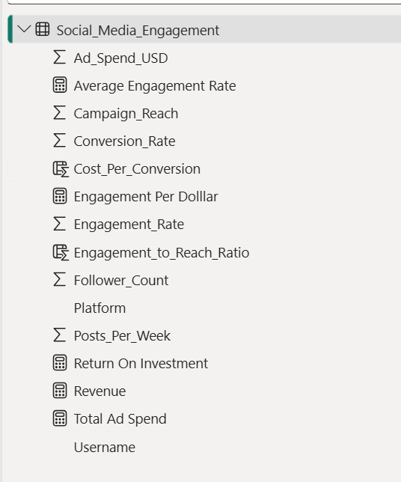
Data Integration & Cleaning
📌 Loading & Exploring the Data
Identified key attributes: engagement rate, ROI, ad spend, follower count
📌 Handling Missing Values
Original dataset had missing values in: Ad Spend (USD), Engagement Rate, Conversion Rate
Used mean/median imputation for numerical values.
Removed records having a large amount of missing data.
📌 Removing Duplicates ( None found)
📌 Formatting & Standardization
📌 Created Calculated Columns/Measures (DAX in Power BI)

Slide 4
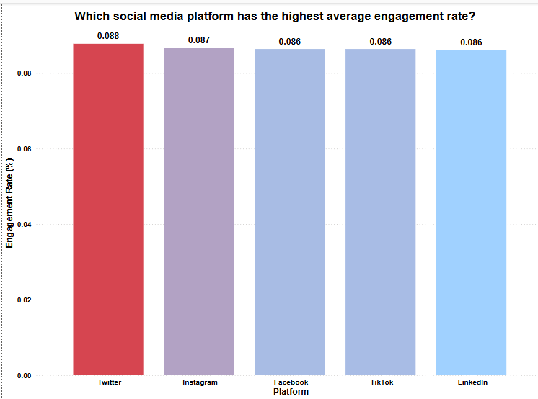
Question 1: Which social media platform has the highest average engagement rate?
Twitter (8.8%) offers the highest level of engagement and involvement.
Instagram (8.7%) is great for images and influencer content.
LinkedIn (8.6%) has the lowest interaction and is engagement-limited due to its niche audience.

Slide 5
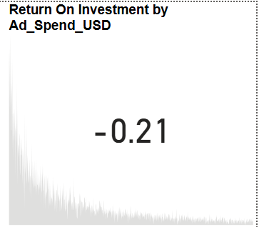
Question 2: Which platform delivers the highest return on investment (ROI) for ad spend?
Facebook (0.45 ROI) provides the best return on ad spend.
Twitter (0.42 ROI) is effective but relies heavily on engagement.
TikTok (0.35 ROI) has the lowest ROI, needing better ad targeting.

Slide 6
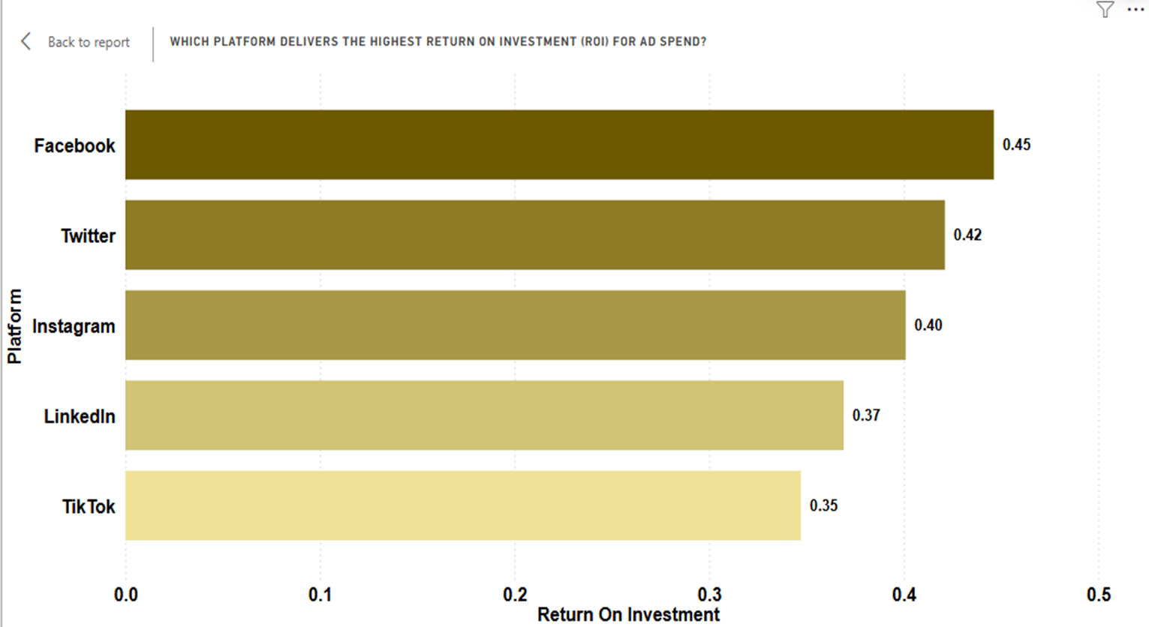

Slide 7
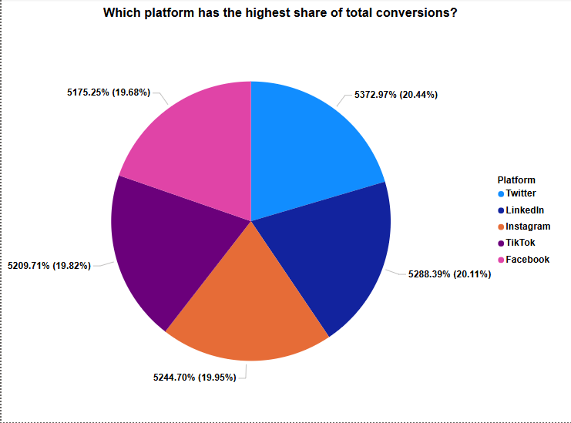
Question 3: Which platform has the highest share of total conversions?
Twitter has the highest conversion share (20.44%), showing strong audience engagement potential.
LinkedIn (20.11%) and Instagram (19.95%) closely follow, proving effective for conversions.
TikTok (19.82%) and Facebook (19.68%) contribute slightly less but remain significant.

Slide 8
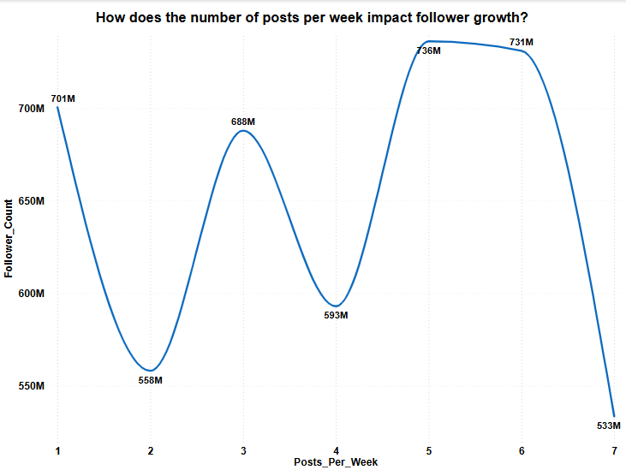
Question 4: How does the number of posts per week impact follower growth?
Posting 3-5 times per week leads to maximum follower growth.
Posting too little (1-2 posts) or too much (6-7 posts) results in slower growth.
The highest follower count (736M) was recorded at 5 posts/week.

Slide 9
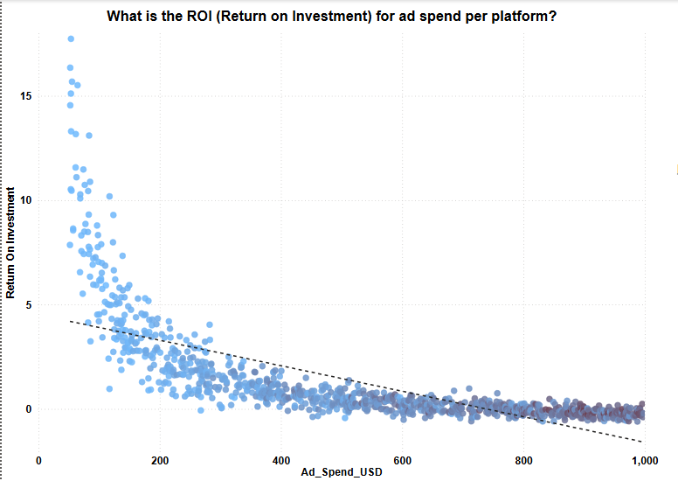
Question 5: What is the ROI (Return on Investment) for ad spend per platform?
ROI is highest when ad spend is less than $400.
Beyond $400, returns decrease, implying that increased spending equals higher ROI.
Some low-budget initiatives outperform high-volume expenditures.

Slide 10
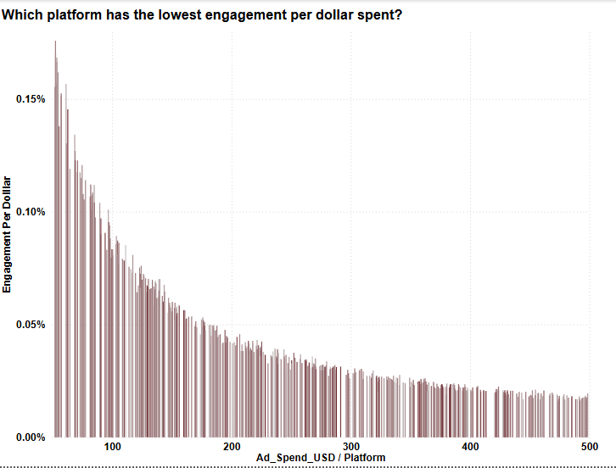
Question 6: Which platform has the lowest engagement per dollar spent?
Engagement per dollar decreases as ad spend rises.
Ad spends under $100 generate the highest engagement.
Above $300, engagement stabilizes, showing reduced efficiency.

Slide 11
Question 7: How does engagement rate trend over time across platforms?
Posting 3-5 times per week boosts engagement across all platforms.
Inconsistent posting leads to engagement drops.
Different platforms have unique engagement trends, requiring platform-specific strategies.

Slide 12
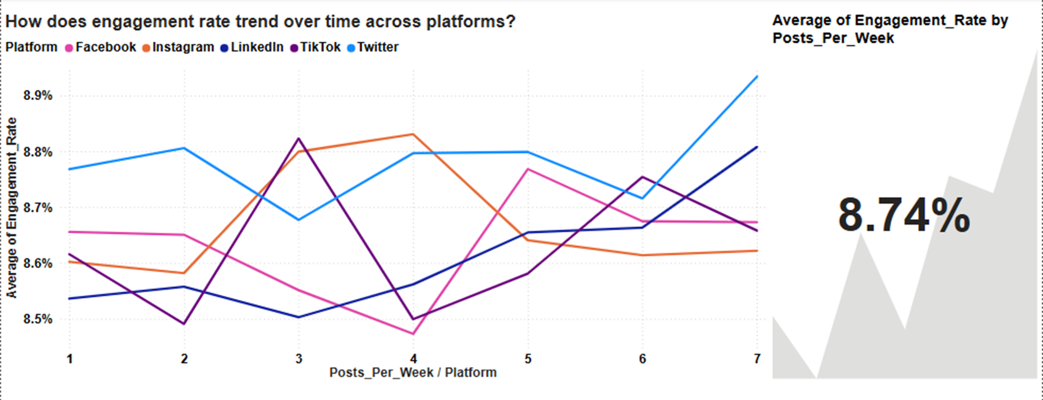

Slide 13
Question 8: Does a Higher Follower Count Correlate with Higher Conversion Rates?
Follower count does not strongly correlate with conversion rates.
1
Engagement levels have a bigger impact on conversions than followers.
2
Some low-follower accounts outperform high-follower accounts in conversions.
3

Slide 14
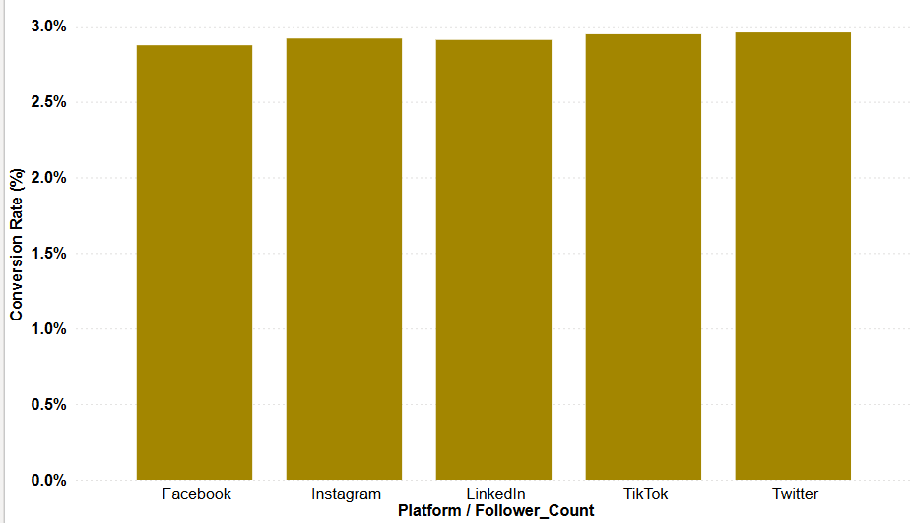

Slide 15
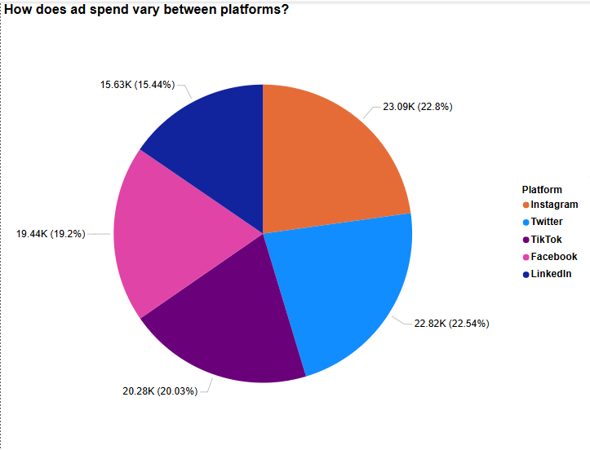
Question 9: How does ad spend vary between platforms?
Instagram (22.8%) and Twitter (22.54%) have the highest ad spend, indicating strong investment in paid marketing.
TikTok (20.03%) and Facebook (19.2%) receive moderate ad budgets, likely for targeted campaigns.
LinkedIn (15.44%) has the lowest ad spend, suggesting a lower focus on paid ads.

Slide 16
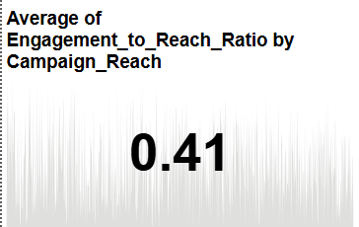
Question 10: Which platform has the best engagement-to-reach ratio?
Instagram (3.9) has the best engagement-to-reach ratio, making it ideal for organic content.
TikTok & Twitter (3.7 each) are highly effective for audience engagement.
LinkedIn (3.6) & Facebook (3.3) have weaker engagement per impression.

Slide 17
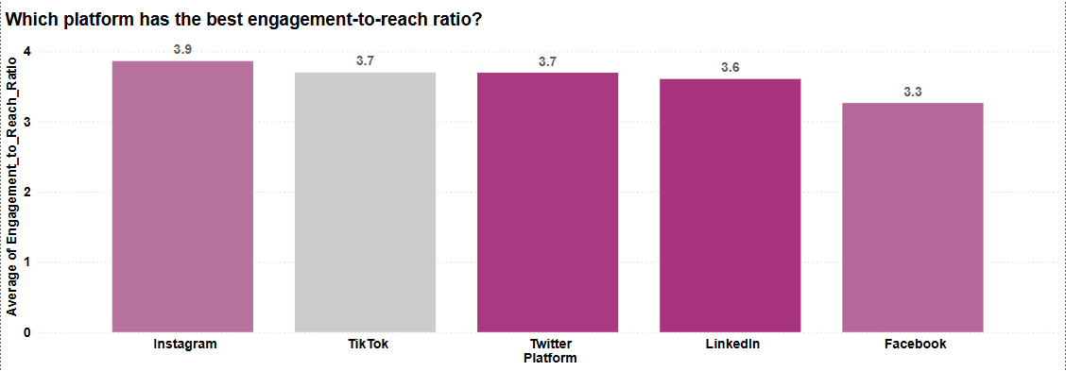

Slide 18
Dashboard Functionality & Interactivity
Demonstrating interactive elements in Power BI
Exploring slicers, filters, and drill-through features
Live walkthrough of dynamic visualizations

Slide 19
Challenges and Solutions
Challenge: Missing values in key metrics (Ad Spend, Engagement Rate, Conversion Rate).
Challenge: Duplicate records in engagement and ad spend data.
Challenge: Missing ROI, Cost Per Conversion, and Engagement Per Dollar metrics.
Challenge: Confusing x-axis behavior when enabling drill-downs.
Challenge: Overloaded visuals made navigation difficult.
Solution: Used Power Query Editor, applied mean/median imputation, and removed excessive missing data.
Solution: Used "Remove Duplicates" in Power BI and created unique identifiers.
Solution: Developed custom DAX formulas for meaningful analysis.
Solution: Adjusted hierarchy structure & slicer settings for smooth transitions.
Solution: Structured sections, used color coding, and added contextual insights.

Slide 20
More Challenges and Solutions
Challenge: Filters affected unrelated visuals, causing inconsistencies.
Challenge: KPI cards did not update dynamically with filters.
Challenge: Variability in engagement & conversion rates made analysis inconsistent.
Challenge: Extreme ROI and engagement values distorted results.
Challenge: Too many charts reduced clarity.
Solution: Used Power BI’s "Edit Interactions" to refine slicer control.
Solution: Linked KPI cards to slicers & conditional formatting.
Solution: Used drill-downs & slicers for platform-specific insights.
Solution: Applied trend analysis using scatter plots.
Solution: Used appropriate chart types (bar, pie, scatter, line), white space, and intuitive labels.

Slide 21
Conclusions
Conversion and Audience Growth
TikTok, Instagram, and Facebook generate the most conversions.
Post 3-5 times each week to maximize follower growth.
Budget Allocation and Cost Efficiency
Spend less than $100 each ad for the highest engagement per dollar.
Reallocate budget from underperforming platforms.
Data-Driven Decision Making
Use drill-down analysis and KPI tracking to gain insights.
Optimize conversion tracking to prevent errors.
Platform Engagement Strategies
Prioritize Twitter and Instagram for high interaction.
LinkedIn is ideal for professional material.
ROI and Ad Spend Optimization
Invest in Facebook and Twitter ads for a higher ROI.
Optimize TikTok ad targeting to increase interaction.
To maximize profits, keep your ad budget under $400.

Slide 22
Recommendations
Social Media Marketing Strategies
Businesses should prioritize content channels that generate high interaction.
Optimize publishing frequency to keep the audience interested.
Ad Campaign Optimization
Allocating money to top-performing platforms can help you maximize your ROI.
Use data-driven insights to improve your targeting methods.
Cost-effective digital advertising
Maintain expenditure within the ideal ranges for ad efficiency.
Adjust ad spending dynamically based on KPI performance.
Enhanced Audience Analytics
Track engagement trends to optimize user interaction.
Use drill-down features to analyze performance by platform.
Business Decision Making
TikTok and Instagram can help e-commerce firms improve conversion rates.
B2B organizations can use LinkedIn to expand their professional reach.

Slide 23
Thank you

